Slide 1
Welcome to Open House
Heritage Trails Community School
Middle and High

Slide 2
Team and Contacts
Moses Johnson – Dean of Secondary johnsonm9@leonschools.net
Christian Amos - Physical Education, Math 6-8, Algebra 1A amosc@leonschools.net
Bryan Bair – World History, Civics, US History, US Government bairb@leonschools.net
Elizabeth Bigness – Science 6-8, Algebra 1B, Math for College Readiness, Geometry bignesse@leonschools.net
Gregory Buchanan – English 1-3, Intensive Reading, Journalism, Theatre buchanang@leonschools.net
Charles Chatman – ELA 6-8, English 4, Intensive Reading chatmanc@leonschools.net
Jason Martin – Earth Space Science, Physical Science, Biology martinj@leonschools.net
Kenneth Wright – Economics, Government, World History, US History wrightk2@leonschools.net

Slide 3
Restorative Practices
At the heart of Heritage Trails is the Relationship Agreement. This document is a living, collaborative effort among school staff and students expressing agreement of expectations in four domains of on-site relationships: Staff to Student, Student to Staff, Student to Student, Everyone to Campus. (see slides 14-15)
Weekly Connection Circles allow for the building and sustaining of relationships on campus. Each class takes time to pose questions to both students and staff with the purpose of building empathy and understanding, while also strengthening speaking and listening skills.
Daily Check-Ins using Feelings and Needs Statements are utilized in order to teach and model Social and Emotional Maturity as well as to proactively meet the needs of our students. (see slide 16)
When an action has been taken which damages a relationship, a Restorative Session is held. This is a mediation including all parties involved where the facts are recalled, feelings are shared, a fix is discovered, and the future is discussed. Using this approach we are able to repair harm and maintain community.

Slide 4
Technology
For academics, each student is given access to a Chromebook; be sure to review and complete the Chromebook Agreement Form.
ClassLink is where students can find access to every Leon County Schools app, including MS Office, Student Email, and FOCUS.
FOCUS allows students and parents to access student grades, attendance, schedule, and more.

Slide 5
Meet the Secondary Staff

Slide 6
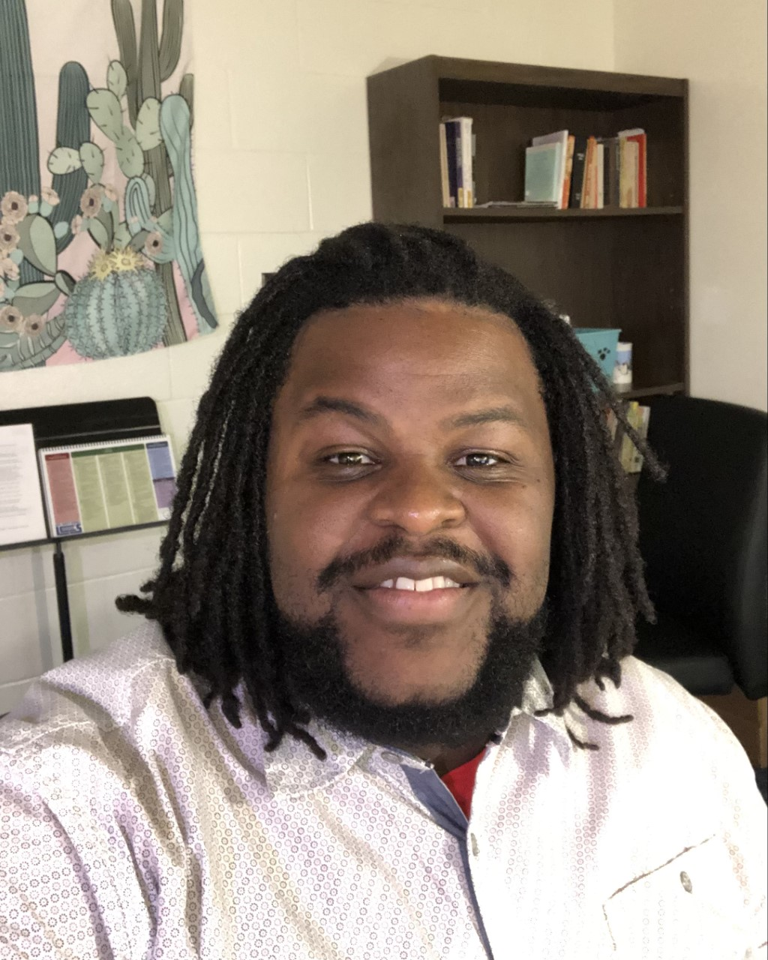
Moses Johnson
Hello, my name is Moses Johnson III. I am serving as Dean of Secondary this year. I am excited about supporting our instructional staff, engaging students, and strengthening the relationships within our school. I am happy to be facilitating academic interventions and engaging with the school as we continue growing our heritage and creating trails!

Slide 7
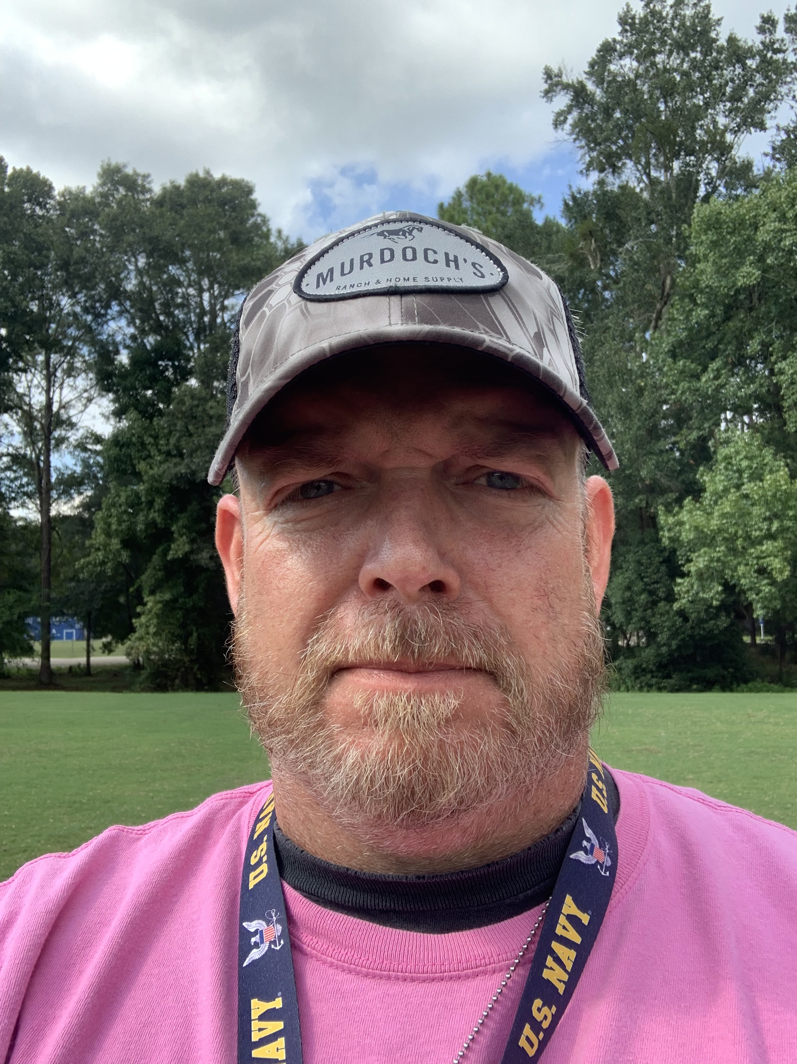
Christian Amos
My name is Coach Amos.
I teach Physical Education and Math 6-9.
Ms. Vasquez assists as Paraprofessional in my classroom.
Things To Know
-I give a lot of credit for effort when grading.
-If you see a grade of 50 or lower in Focus that means the student turned nothing in to grade.

Slide 8
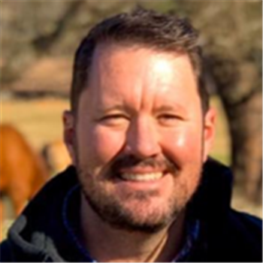
Bryan Bair
Hello, my name is Mr. Bair and I teach World History, Civics, US History, and US Government. This is my 3rd year teaching at Heritage Trails.
Things To Know
-Grades: 75% Class Participation, 25% Quizzes
-Make up work is expected within a week of missed assignments, unless otherwise agreed upon.

Slide 9
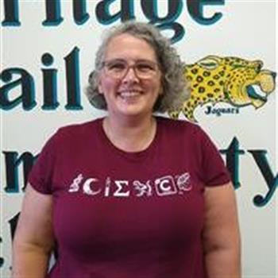
Elizabeth Bigness
I have been teaching middle school science for almost 15 years, this is my first year for high school math.
My paraprofessional is K. James
Things To Know
-I keep healthy snacks in the room so if a student is hungry they can grab something.
-I try to allow students some decompression time on our circle days as long as they have no missing assignments.
-Most assignments can be turned in late (as long as it is in by the last day of the 9 weeks). I also generally allow students to redo tests.
-All of my classes are driven by the Florida State Standards and I use a variety of resources to help students master those standards.
-Geometry and Algebra 1B both have an End of Course Exam and 8th grade Science will take the Statewide Science Assessment at the end of the year.

Slide 10
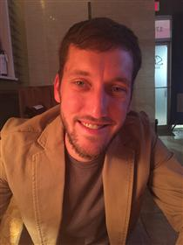
Gregory Buchanan
My name is Mr. Buchanan, this is my eighth year serving as the high school English teacher at Heritage Trails. My goal is to increase the competencies and capacities of my students regarding the access, analysis, evaluation, and creation of text.
Coleman serves as Para for the classroom, having worked for HTCS for the past three years. They add deep care and creativity to the classroom.
Things To Know
-The ELA curriculum consists of Florida Collections, supplemented by CommonLit.
-Application to resubmit work is welcome year-round.
-Official Progress Monitoring is assessed via STAR Reading, and the academic year culminates in the FSA.

Slide 11
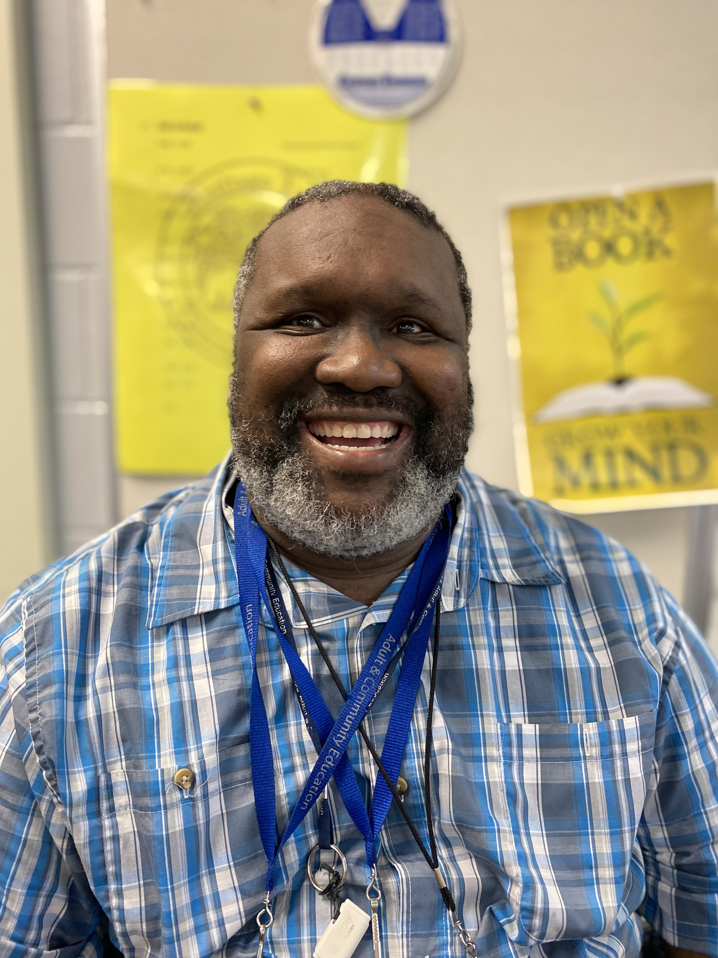
Charles Chatman
My name is Charles Chatman. I will be teaching Middle School Language Arts. Although this is my first year at Heritage Trails, I have over 10 years working with this student population. Ms. K is the paraprofessional for this class and has been at Heritage Trails for 6 years. She has over 40 years working with this student population.
Things To Know
-We are using the Florida Collections Curriculum this school year.
-Work is able to be made up until the day before the nine week due date in Focus.
-Star Reading and Language Live are the two main assessments for the year, along with the FSA.

Slide 12
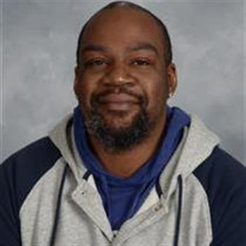
Jason Martin
My name is Jason Martin and I am the high school Science teacher here at HTCS. My goal is to teach students how to apply the scientific method to problems, evaluate hypotheses, and make predictions. Students will get a more advanced understanding of Earth/Space Sciences, Physical Sciences, and Biological Sciences, as well as have the opportunity to explore the use of technology in Science.
My instructional paraprofessional is Ms. Gwendolyn Chambers.
Things To Know
-Each course is taught based on the NGSSS and Florida Science Standards
-Grades: Assignments - 30%, Exams/Quizzes - 60% Participation - 10%.
-Late work loses 10% for each day it is past due.

Slide 13
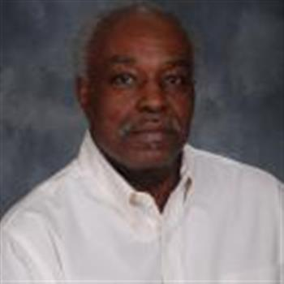
Kenneth Wright
My name is Mr. Kenneth Wright, I am responsible for teaching high school social science. At this time, I am teaching U.S. Government, World History, U.S. History, and Learning Strategies. The instructional para for our class is Ms. Jacqueline Pye.
Things To Know
-Students are expected to enter the classroom in an orderly manner and be prepared to work on the day’s assignment.
-Canvas is the platform by which instruction is delivered. It is a computer-based program, found on ClassLink.
-Students may make up any work during the 9-week period the assignment is given. Students may request additional work at any time.
-There is an End of Course (EOC) exam for U.S. History, required by the school district.

Slide 14
Relationship Agreement
Staff to Students
Students to Staff
Speak with kindness
Take time to listen to students and give students time to answer
Ask students to put something away instead of taking it
Be encouraging
Seek to understand student’s perspective
Recognize personal space
Speak with kindness
Be encouraging
Listen to what staff are saying
Tell staff how you are feeling/thinking
Be honest
Use appropriate tone of voice and appropriate language
Recognize personal space

Slide 15
Relationship Agreement
Students to Students
Everyone to Campus
Speak with kindness
Help others make good choices
Be safe with each other
Get to know each other
Forgive each other
Be honest/keep your word
Be polite and encourage each other
Handle disagreements restoratively
Use appropriate language
Recognize personal space
Clean up your mess
Pick up and throw away trash
Be safe with furniture
Take care of our property (supplies, computers)
Keep appropriate noise level – no screaming, yelling
Ask for help with equipment

Slide 16
Feelings and Needs
Categories of Feelings
Categories of
Needs
Peaceful
Loving
Glad
Playful
Interested
Mad
Sad
Scared
Tired
Confused
Health
Security
Peace
Expression
Creativity
Meaning
Connection
Understanding
Community

